Slide 1

World Electricity Analysis
“A transition to clean energy is about making an investment in our future”
Kuldeep Singh Shekhawat
Mayank Sinha
Pranjali Patel
Vaibhav Jadhav

Slide 2
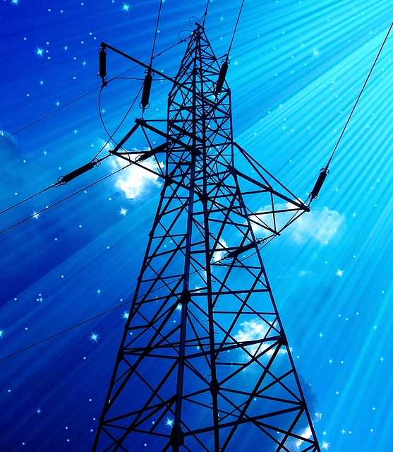
Introduction
Problem Statements :
How is production of electricity across different sources.
Find a trend, how the count of countries having more than 75% of access in rural.
Comparison of access to electricity post 2000s in different countries.
Define a way to present the evolution of nuclear power presence grouped by Region and Income group.

Slide 3

Strategy:
We discussed the strengths of teammates & distributed the work accordingly.
We distributed the tasks on daily basis.
We brainstormed the problem statements together.
Ensure effective communication within the team.

Slide 4
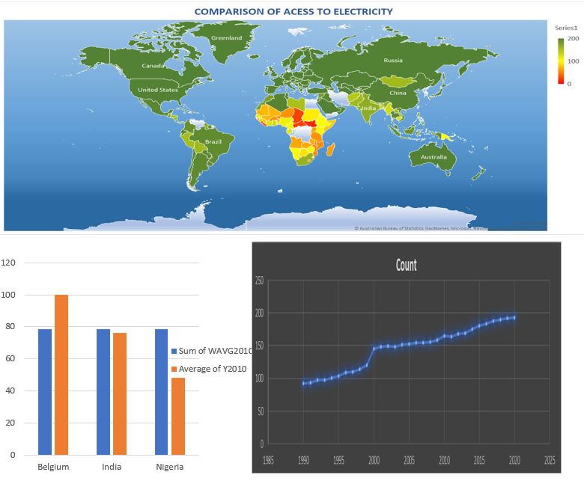
Problem Explanation

Slide 5
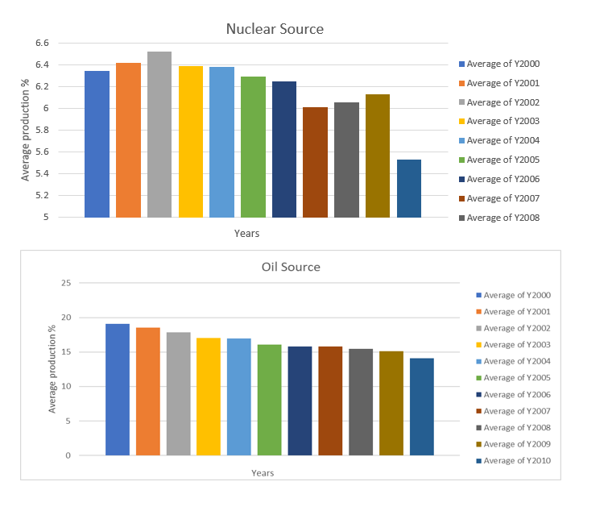
Problem Explanation

Slide 6
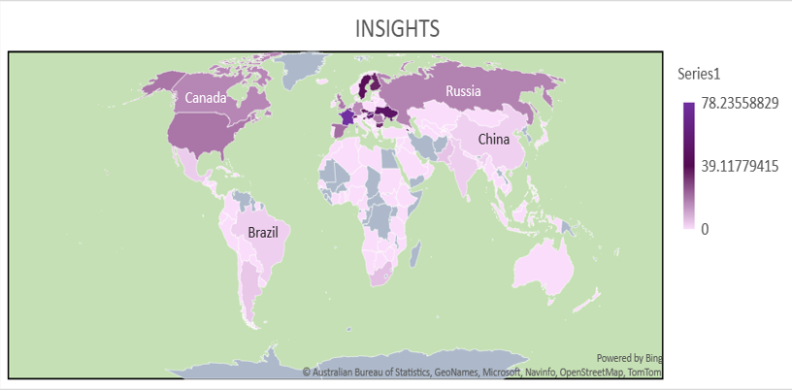
INSIGHTS
Only 25% countries have the nuclear electricity generation capacity.

Slide 7
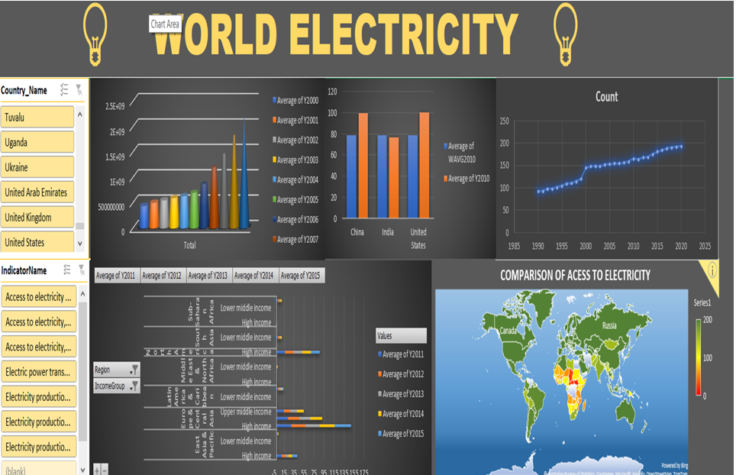
DASHBOARD

Slide 8

CHALLANGES
Technical :
Incomplete and inconsistent data.
Difficulty during performing aggregation on SQL.
Non Technical:
Coordinating time with subordinates.
All were having a different approach to solve a particular problem

Slide 9

Conclusion
Almost 60% of the countries have electricity accessibility rate of greater then 90%.
Less than 10% countries have transmission and distribution losses above 20%.
Rural areas of more than 100 countries have less than 50% electricity accessibility.
All countries are primarily dependent on oil sources to produce electricity.

